Slide 1
ADHD doesn’t exist?
A statistical approach

Slide 2
Normal?
Nurse: she is way too light
Me: ????
Nurse: she belongs to the lowest percentile!
Me: Wow, Should I give more food?
Nurse (glad that I am so clever):Yes yes, you certainly should
Me: so she will be heavier next time?
Nurse: Sure sure
Me: but then, another baby will be in the lowest percentile!

Slide 3
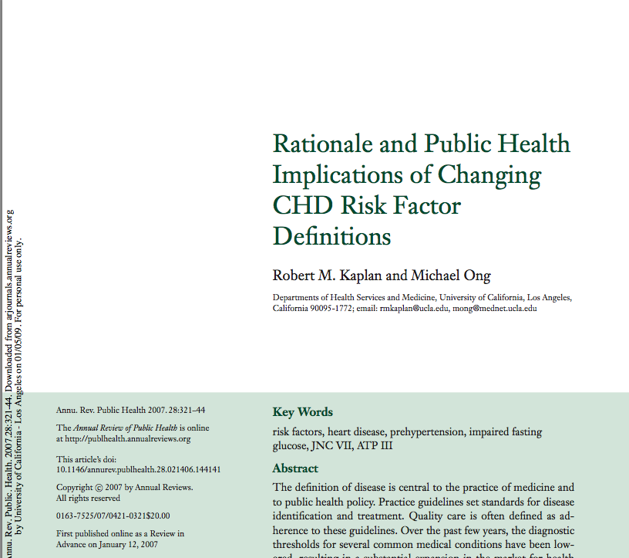
Who is sick?
According to proposed criteria, a vast majority of elderly will be classified chronic patient. More pills will be sold.

Slide 4
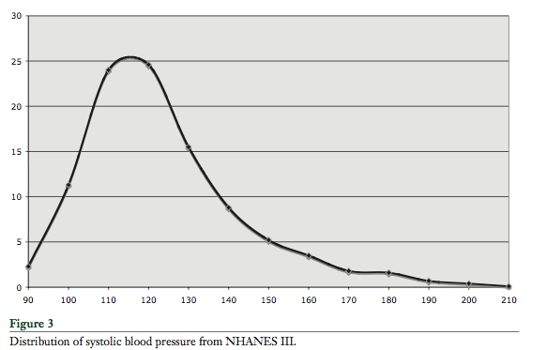
Blood Pressure distribution who is sick? Pre-hypertension!
Morbidity correlates with pressure
NORMAL
INTERVENTION
ABNORMAL

Slide 5
Proposal
1: No interventions on the basis of X standard deviations but on the basis of deviations from a normal distribution or validated process model of disease. Allow normal variation!
2: Testing the score-distributions of ADHD Questionnaire (general population).
Using the score distribution for autism disorders as a control?

Slide 6
Methodological issues
In a homeostatic system the null distribution differs from normal?
Null distribution might be skewed due to asymmetric floor and ceiling constraints.
What is the effect of bin width on the sensitivity of testing a distribution vs. a null distribution.
Multiple causes might obscure each other.

Slide 7
On-line preregistration
Questionable research practices
Majority of researchers do p-hacking
Can be prevented by proper pre-registration
Open Science Framework
Fits the scientific work flow
Each edit is timestamped.
Psychological Science will stimulate
http://openscienceframework.org

